Slide 1
Multilevel Co-authoring Of Open Education Resources: Collaborating With Students For The Creation Of Course Materials -or- Writing Nice, Free Textbooks With Friends
Jonathan Emery | Assistant Professor of Instruction, MSE Assistant Director of Graduate Studies, MSE
Chris Diaz | Digital Publishing Librarian

Slide 2
Outline:
30 minutes project description
30 minutes demo/hands-on exercise
30 minutes optional discussion
http://bit.ly/emery-teachxperts

Slide 3
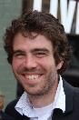
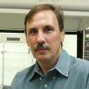
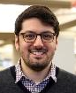
Provost’s Affordable Instructional Resources Initiative (2019)
$5K grant to develop open educational resources for undergraduate courses
Free
Distributed online
Available to be copies, adapted, etc.
MSE proposal
Develop OER text for MAT_SCI 201-301 (and others)
Develop scalable OER co-authoring workflow
Evangelize approach
Jonathan Emery, MSE
Ken Shull, MSE
Chris Diaz, Libraries
https://air.northwestern.edu/get-started/oer-grants/

Slide 4
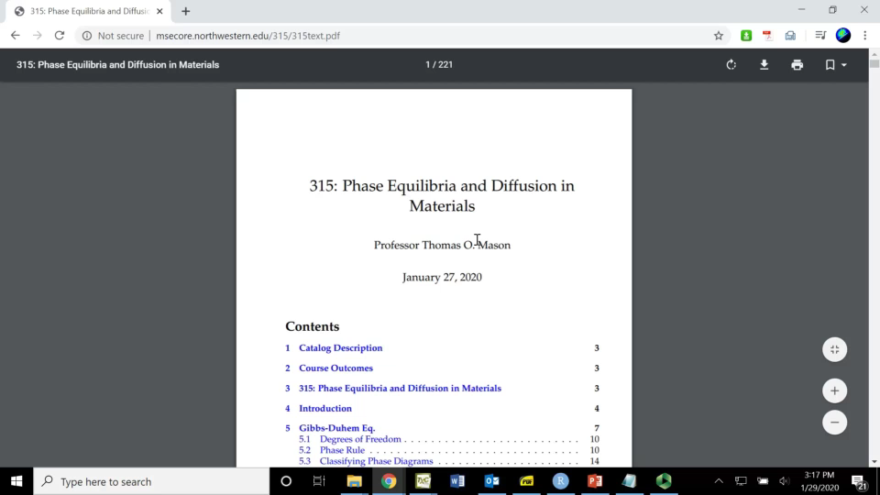
Where We’re At – Conventional Texts
http://msecore.northwestern.edu/

Slide 5
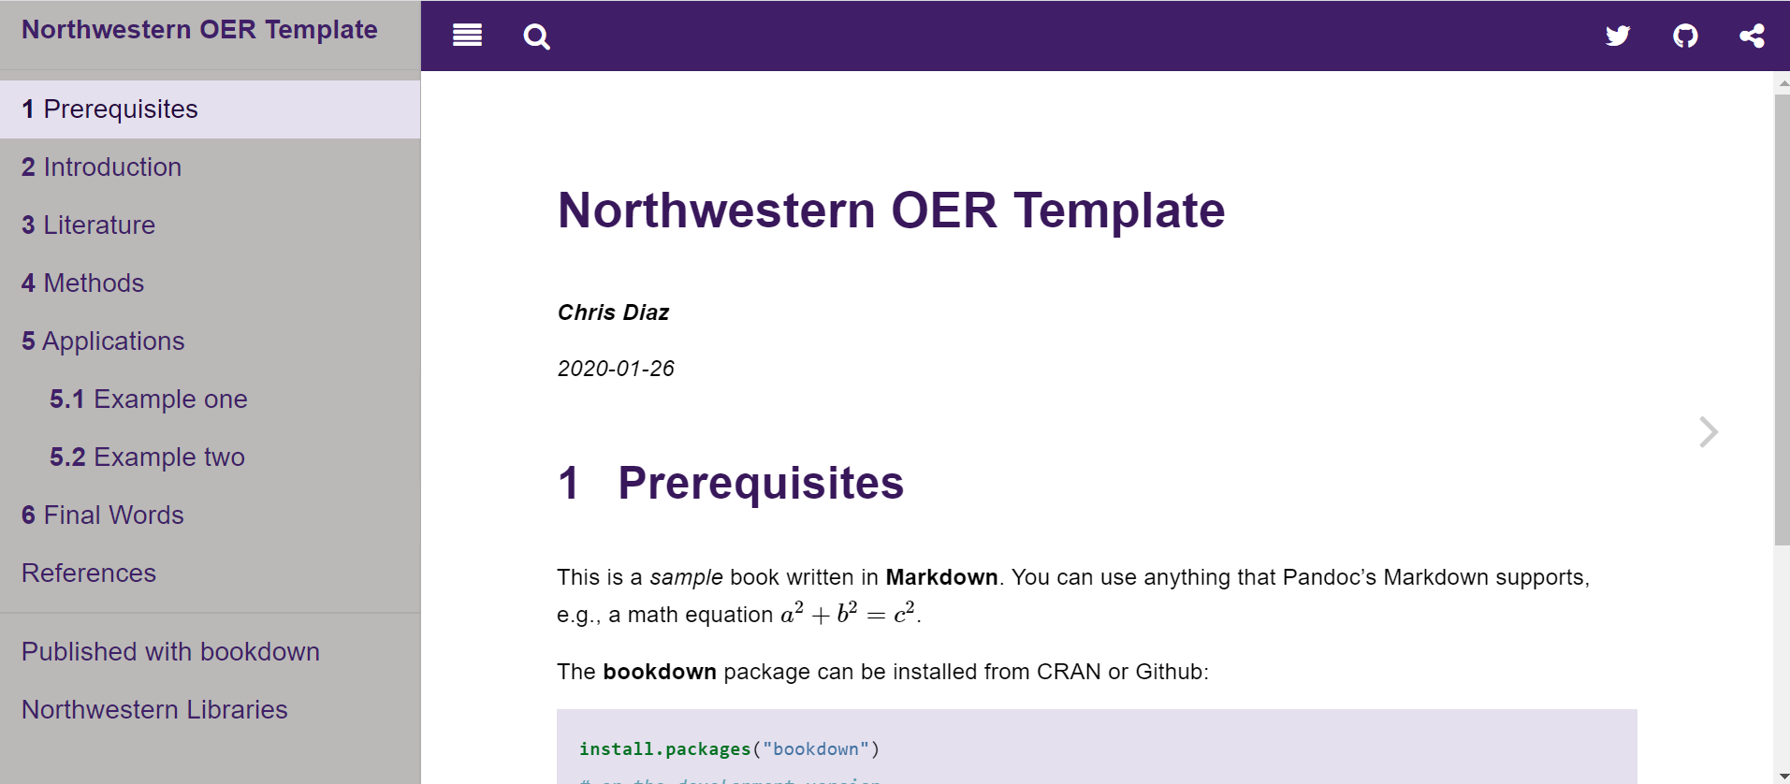
Where We’re Headed – Rich, Web-based Texts
https://chrisdaaz.github.io/bookdown-sandbox/

Slide 6
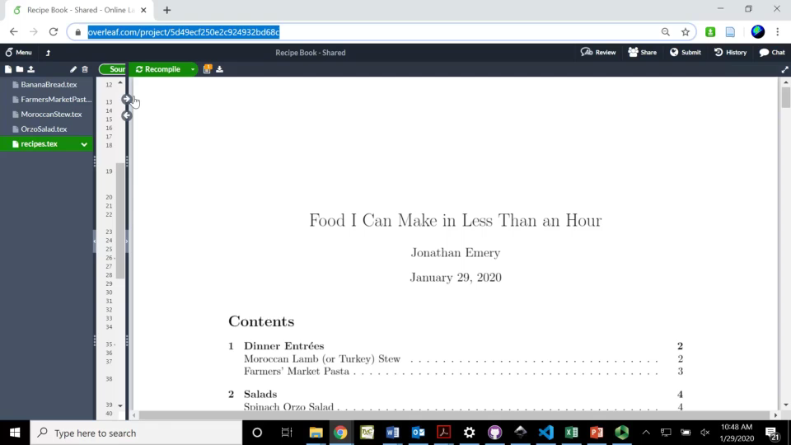
What We’ll Do – Recipe Book!
http://bit.ly/emery-teachxperts

Slide 7

Step 1: Organization
Creating a Textbook:
Identify candidate course that can benefit from OER
Win Affordable Instructional Resources Initiative grant!
Hire work-study students
Organize project
Learn typesetting and graphics-editing software
Create course text templates
Run workshops for work-study students
Software orientation
Copyright/intellectual property
Accessibility training
Organize project tasks
GitHub
Notes:
Starting off, this is pretty low-barrier

Slide 8
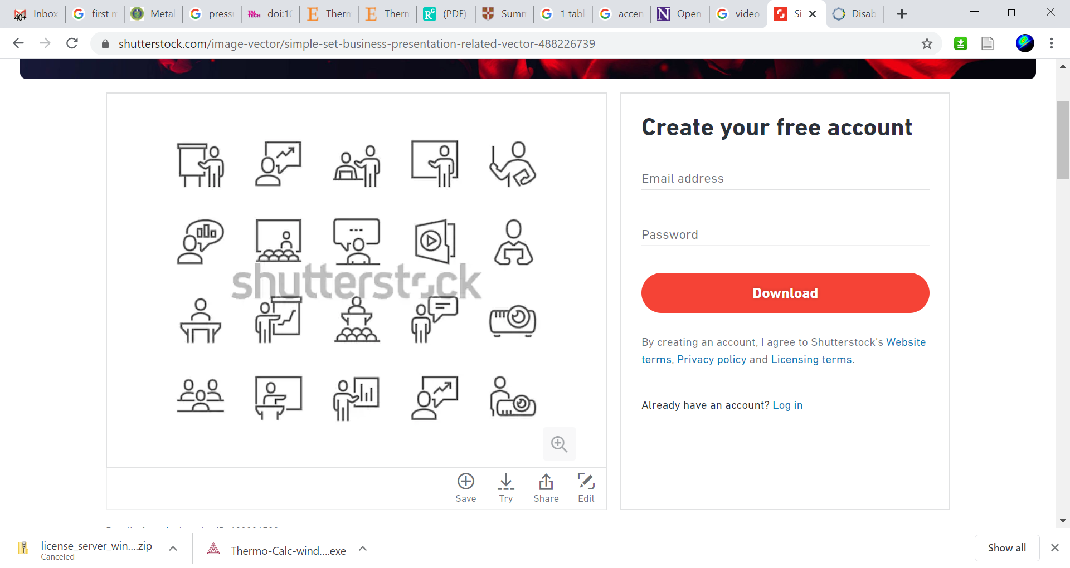
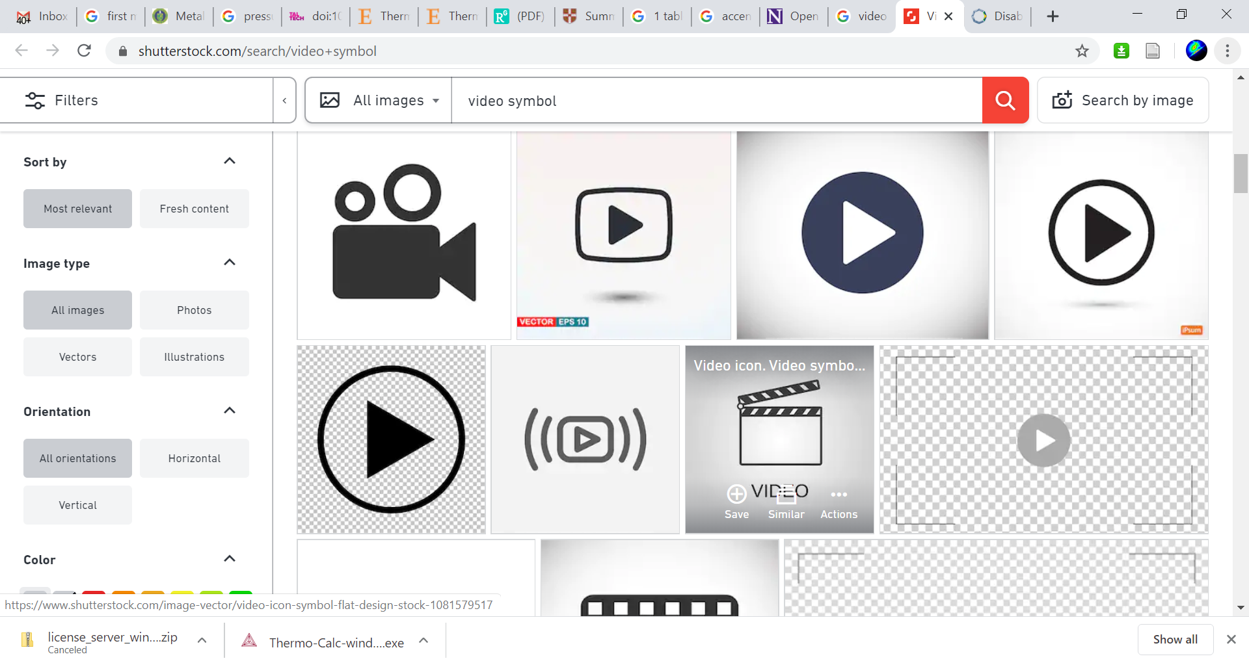
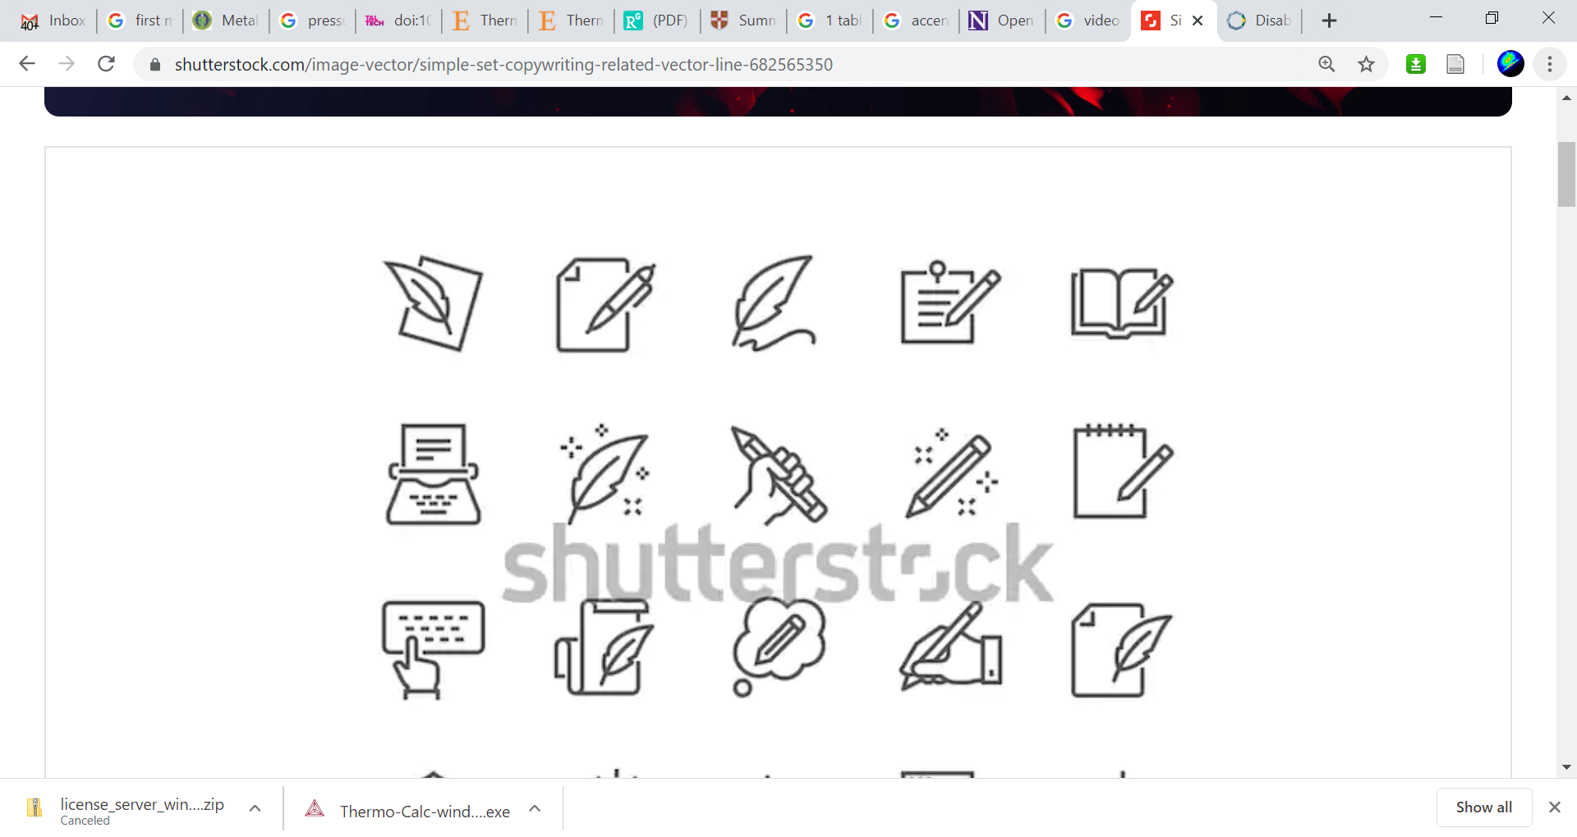
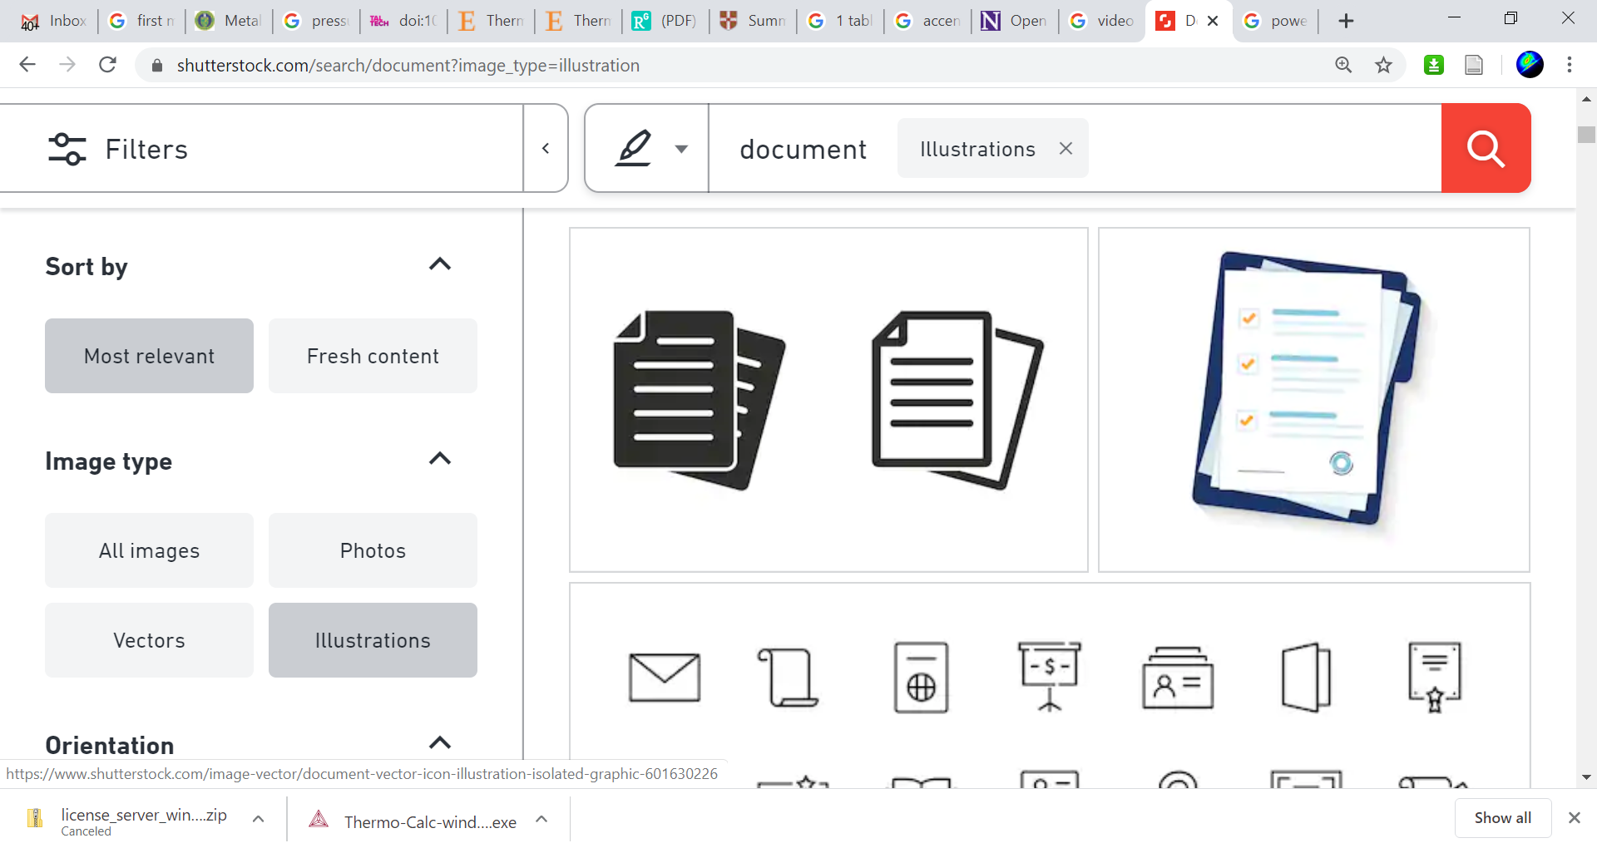
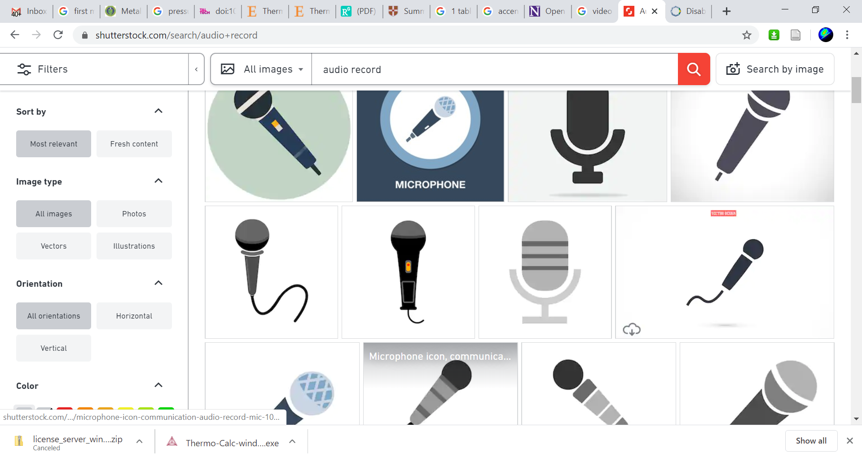

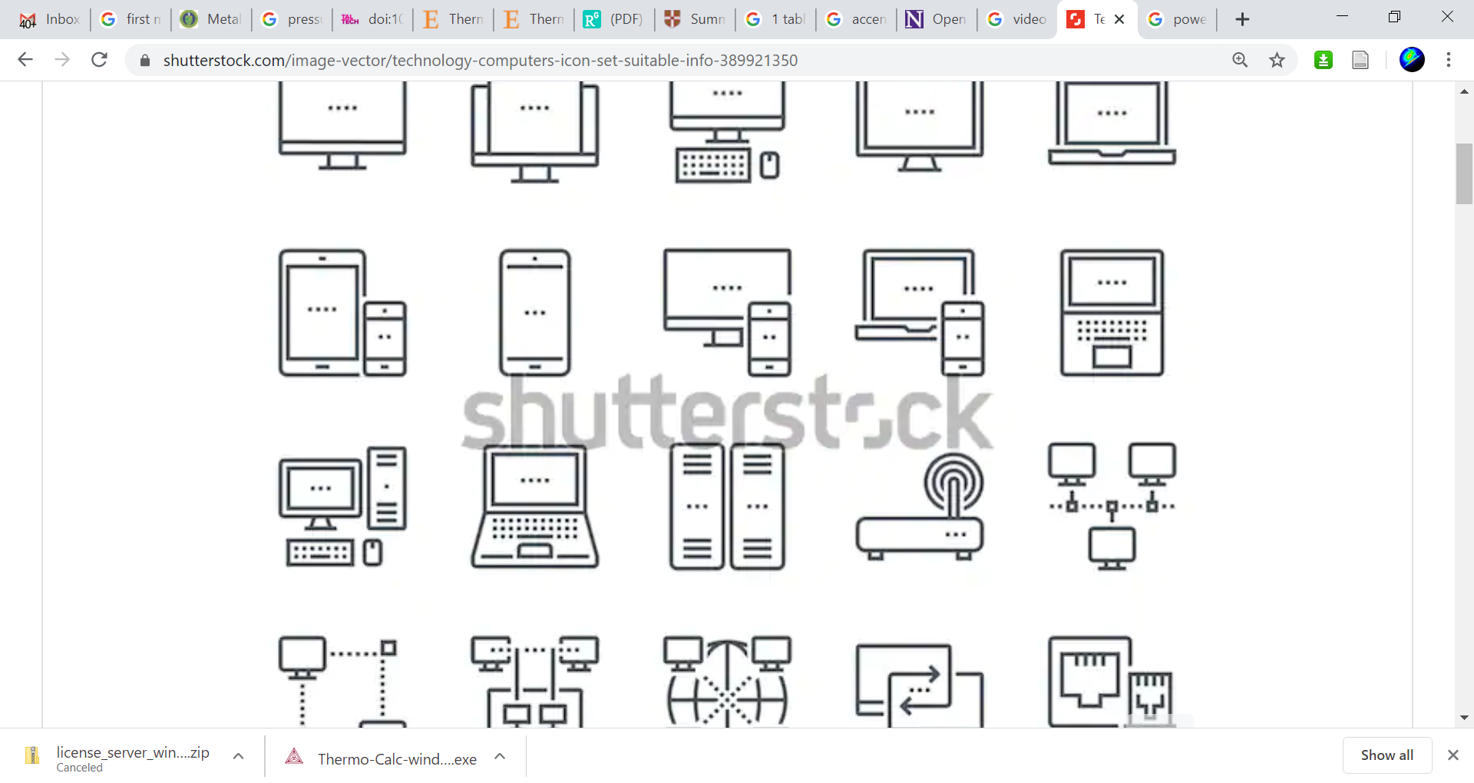
Step 2: Acquire Notes
Creating a Textbook:
Instructor(s)
(2-3 Undergraduate Work-Studies)
Notes:
Starting off, this is pretty low-barrier

Slide 9



Step 3: (Soon after!!) Draft Course Notes
Creating a Textbook:
Text – LyX (LaTeX) and Bookdown (R, Markdown)
Figures - Inkscape

Slide 10
Step 4: Editing and Project Management
Creating a Textbook:
GitHub:
Localized/Delocalized file management
Version control
Project management/task delegation
Bonus:
Co-teaching
Computational assignments
Complete course materials

Slide 11
Course | Cognizant Faculty | Medium | Census (students/yr) | Status
201-301 (Intro) | Emery, Wolverton, Shull | Bookdown | 300+
314 (Thermo) | Barnett, Luijten, Lauhon | Physical Text | 30
315 (Thermo 2) | Wolverton, Mason, Emery | PDF | 25
316-1 (Micro.) | Joester, Voorhees, Shull | PDF | 25
316-2 (Micro.) | Joester, Voohees, Shull | PDF | 25
318 (Selection) | Carr, Shull, Emery | LaTeX | 80+
331 (Polymers) | Huang, Shull | PDF/LyX | 25
332 (Mech.) | Shull, Dunand, Emery | PDF/LyX | 25
351-1 (Sol. State) | Lauhon, Hersam, Snyder | Physical Text | 25
351-2 (Sol. State) | Lauhon, Hersam, Snyder | Physical Text | 25
361 (Crystal) | Emery, Bedzyk | Physical Text | 40
390 (Design II) | Olson, Shull | Notes | 30
391 (Design I) | Chung | Physical Text | 30+

Slide 12
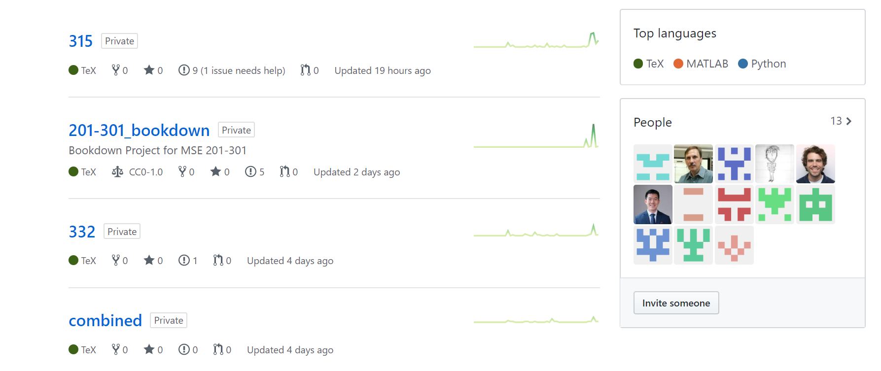
Status and Workflow: MSE Core
https://github.com/msecore

Slide 13
Lessons Learned
Make GitHub simple. Limit to:
Commit: logs the changes you’ve made to GitHub’s “memory”
Push: Sends all changes to the remote repositories
Fetch: Checks status on remote repository
Pull: Downloads changes that may exist on the remote repository
Utilize the capabilities of issues and projects on GitHub
Give students basic training in tools
Think twice about 1st-year engineering work-study students…
Still takes a lot of time…

Slide 14
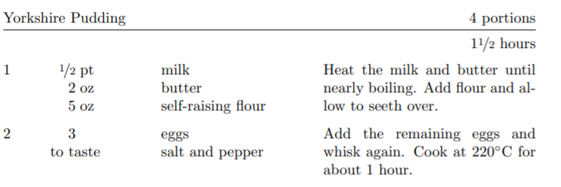
Activity: Let’s Co-author a Recipe Book
https://github.com/chrisdaaz/recipe-bookdown
https://chrisdaaz.github.io/recipe-bookdown/

Slide 15
Workflow
http://bit.ly/emery-teachxperts

